Slide 1
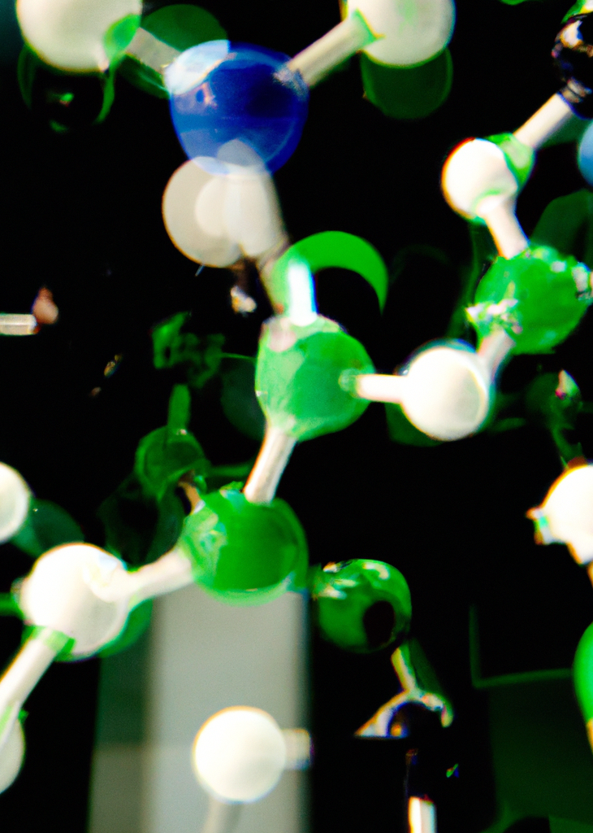
CH-315
Modeling Lab
September 2025
EPFL

Slide 2
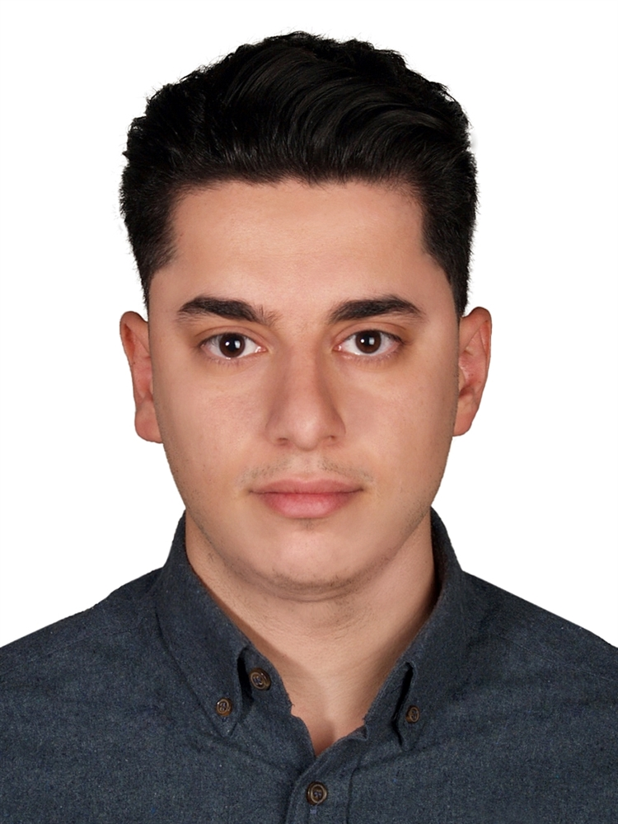
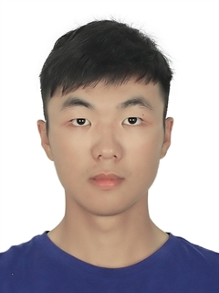

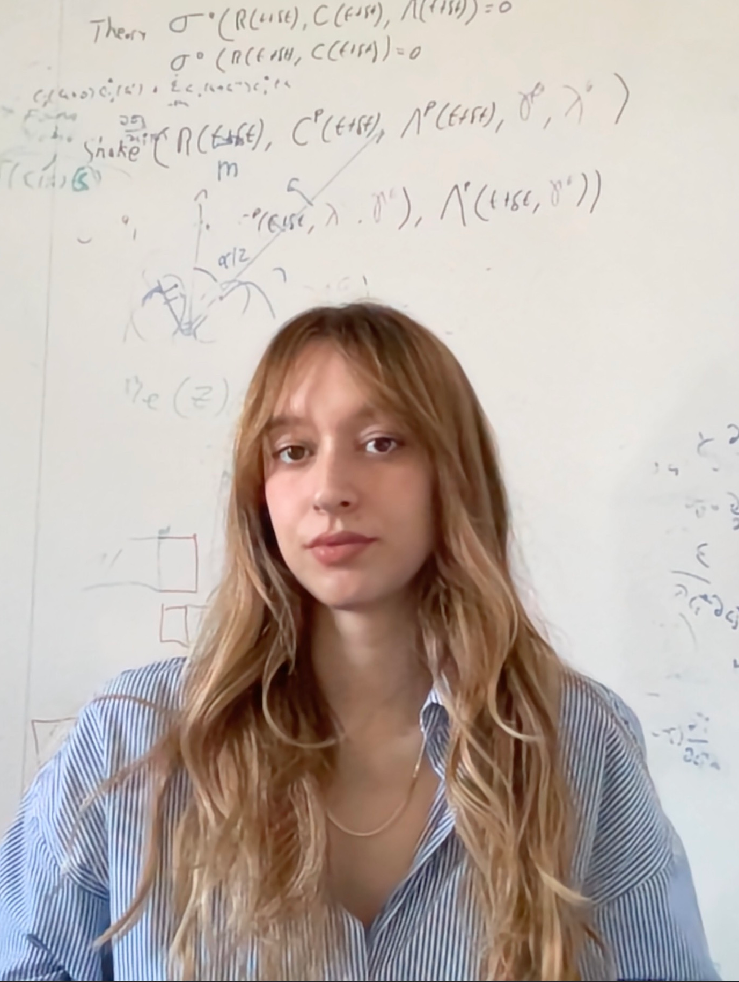
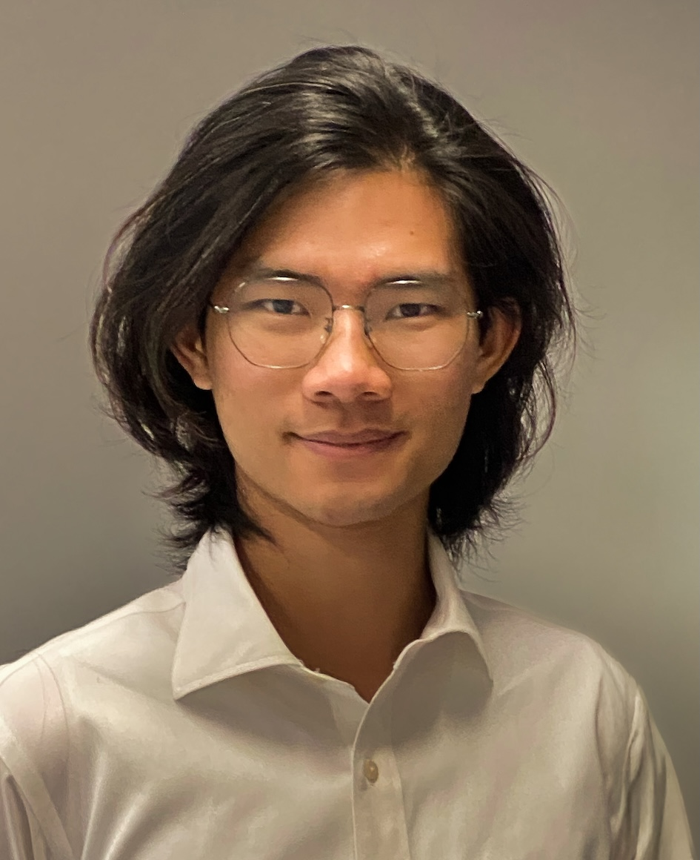
TA Team
Amir Elahi
Coordinator
Yutao Li
Xin Jin
Alessia Ghidini
Boyu Ouyang

Slide 3
TA Team
If you have any question regarding the organization of the course, grades, submissions, deadlines, groups …
Email to amir.elahi@epfl.ch or ask in class
If you have a question related to the material, you either:
  Ask in class
  Email us
You can open a forum on Moodle to start a discussion

Slide 4
Course Organization
The course will be divided into three blocks
  Block 1: Computational Carpentry
  Block 2: Molecular Simulations on Adsorption
  Block 3: Machine Learning in Chemistry and Chemical Engineering
Deliverables
  Block 1: Project
  Block 2: Assignment 1, Assignment 2, Project
  Block 3: Assignment, Project
  Each Group is required to submit only 1 report with all members name in the report
  Naming: Group#_Block#_Assignment/project#.zip. This will take you 30 seconds but save us so much time.
    e.g. Group01_Block1_Project1.zip or Group02_Block2_Assingment1.zip
  Quizzes are on Moodle and they are for further practice and highly recommended but are not graded.
You will work in groups of 3
  1 Member only is responsible for submissions!
  All submissions are due on time! On Moodle!
  Deadlines will be communicated at least one week ahead.

Slide 5
Deadlines
The course will be divided into three blocks
  Block 1: Computational Carpentry
  Block 2: Molecular Simulations on Adsorption
  Block 3: Machine Learning in Chemistry and Chemical Engineering
Deliverables
  Block 1:
    Project: Announcement: 17 September, Deadline 26 September
  Block 2:
    Assignment 1, Announcement: 19 September, Deadline 26 September
    Assignment 2, Announcement: 26 September, Deadline 3 October
    Project, Announcement: 3 October, Deadline 17 October
  Block 3:
    Assignment, Announcement: 10 October, Deadline 17 October
    Project: Announcement: 17 October, Deadline 31 October

Slide 6
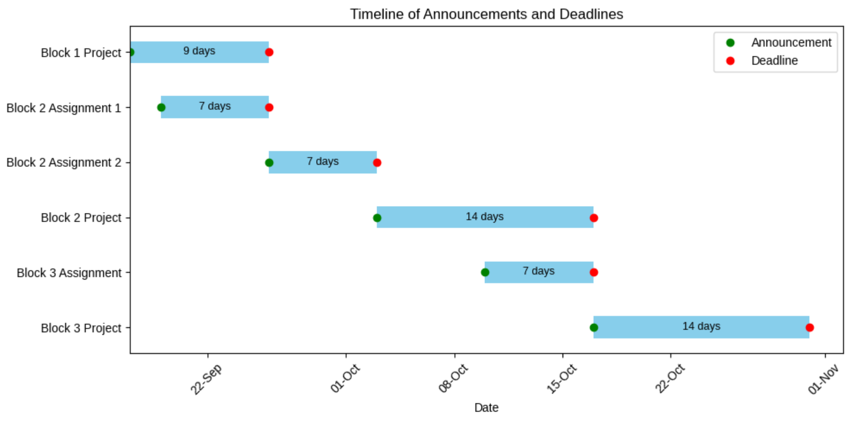
Deadlines

Slide 7
Grading

